Slide 1

Longitudinal Data Spring 2013 March 6
Chapter 5
Introduction to Approaches to Repeated Measures
Chapter 6
Estimation of Marginal (GEE) Models
Instructors
Alan Hubbard, Reuben Thomas
GSI
Katia Eliseeva

Slide 2
Purpose of last class’s problem
Get a first hand feel of defining and estimating variance-covariance matrices of a given data set
Estimate the variance-covariance matrix under two given models of the data generating distribution
Estimate the confidence intervals under each model

Slide 3
Data for our last in-class problem

Slide 4
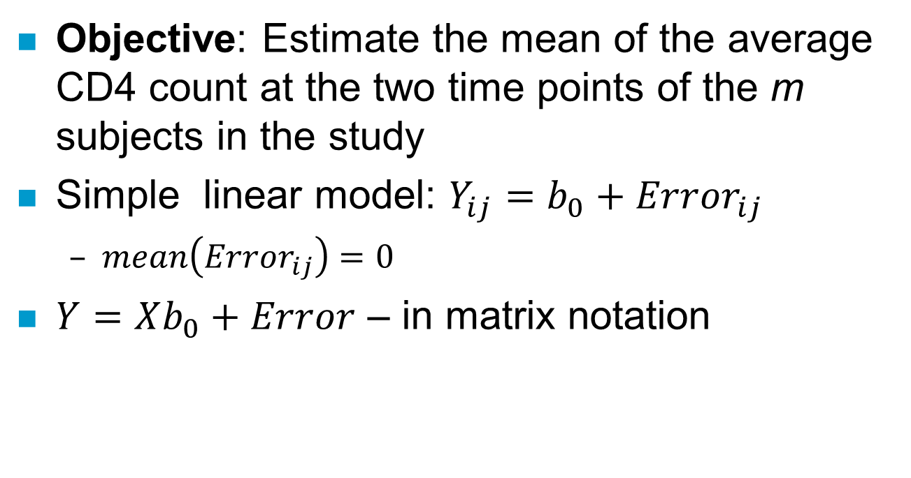
Problem and model of the data
Objective: Estimate the mean of the average CD4 count at the two time points of the m subjects in the study
Simple linear model: $Y_{ij}=b_{0}+{Error}_{ij}$
$mean\left({Error}_{ij}\right)=0$
$Y=Xb_{0}+Error$ – in matrix notation

Slide 5
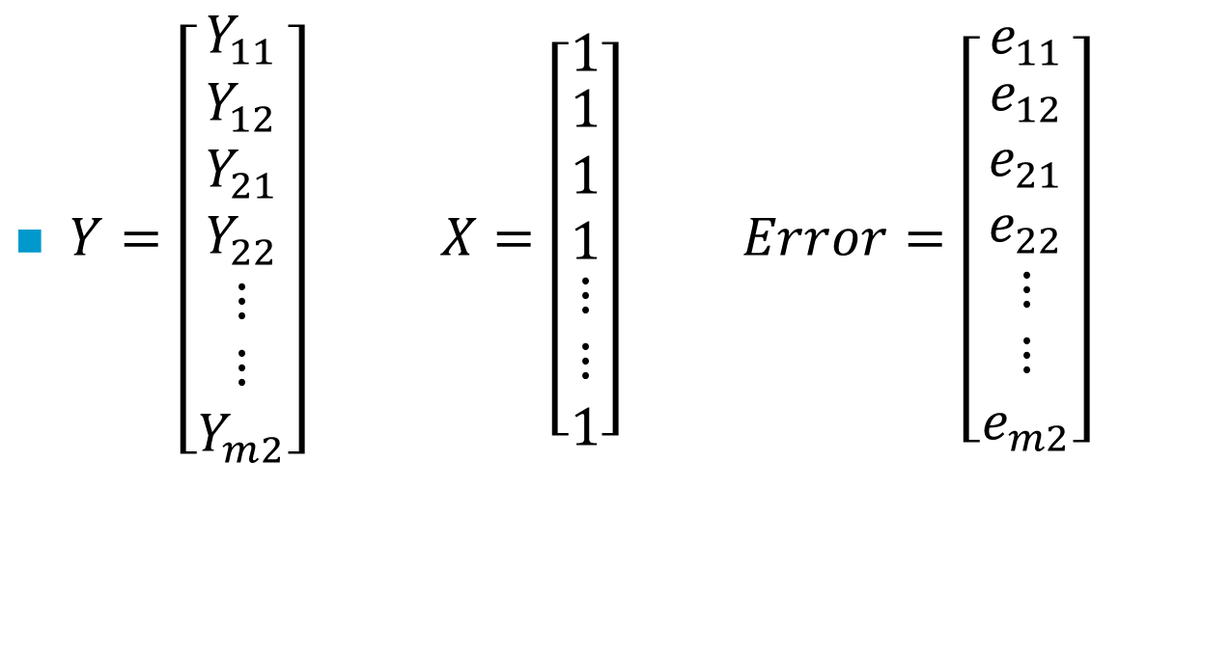
How does Y, X and Error look like?
$Y=\left[\begin{matrix}Y_{11} \\ \begin{matrix}Y_{12} \\ Y_{21} \\ Y_{22}\end{matrix} \\ \begin{matrix}⋮ \\ ⋮ \\ Y_{m2}\end{matrix}\end{matrix}\right] X=\left[\begin{matrix}1 \\ \begin{matrix}1 \\ 1 \\ 1\end{matrix} \\ \begin{matrix}⋮ \\ ⋮ \\ 1\end{matrix}\end{matrix}\right] Error=\left[\begin{matrix}e_{11} \\ \begin{matrix}e_{12} \\ e_{21} \\ e_{22}\end{matrix} \\ \begin{matrix}⋮ \\ ⋮ \\ e_{m2}\end{matrix}\end{matrix}\right]$

Slide 6
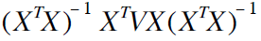
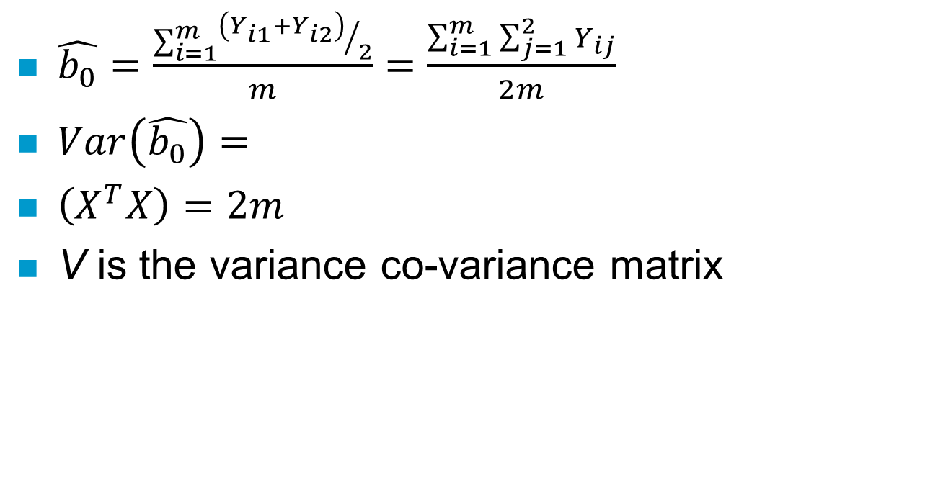
What are estimates of b₀ ?
$\hat{b_{0}}=\frac{\sum_{i=1}^{m}{{\left(Y_{i1}+Y_{i2}\right)}/2}}{m}=\frac{\sum_{i=1}^{m}{\sum_{j=1}^{2}{Y_{ij}}}}{2m}$
$Var\left(\hat{b_{0}}\right)=$
$\left(X^{T}X\right)=2m$
V is the variance co-variance matrix

Slide 7
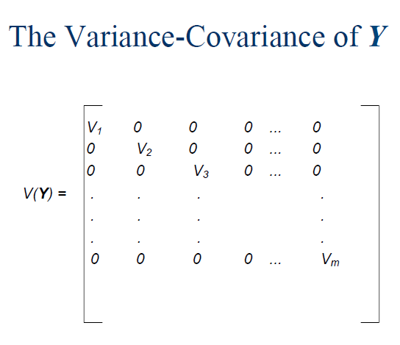

Slide 8
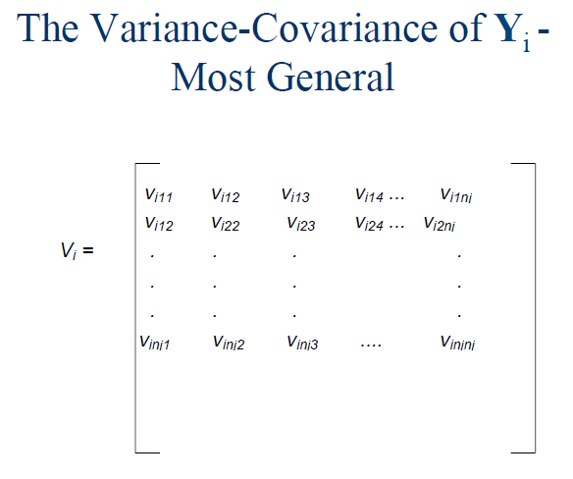

Slide 9
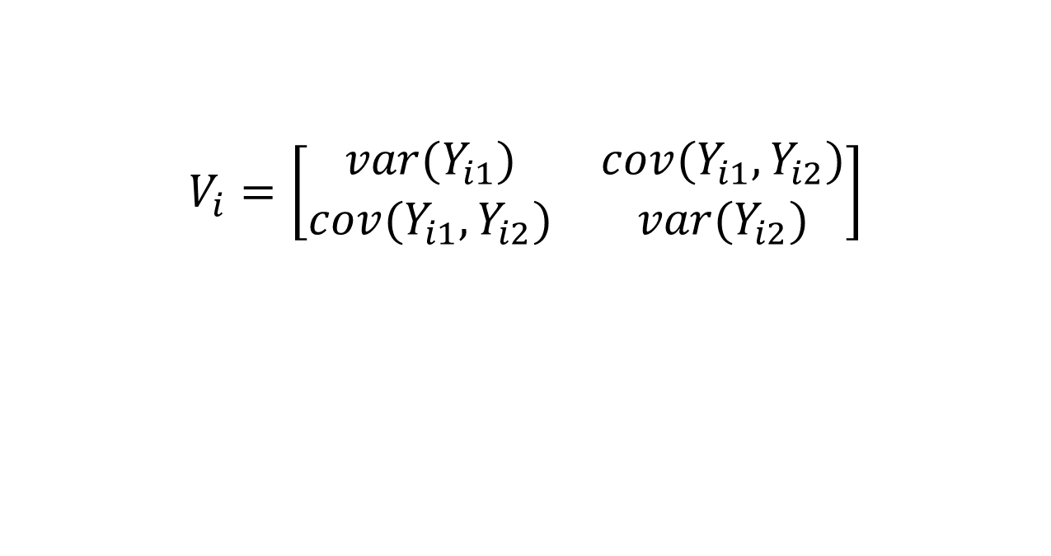
In our case, V_{i} based on two observations per subject
$$V_{i}=\left[\begin{matrix}var(Y_{i1}) & cov(Y_{i1},Y_{i2}) \\ cov(Y_{i1},Y_{i2}) & var(Y_{i2})\end{matrix}\right]$$

Slide 10
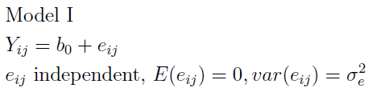
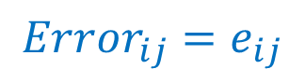

$$Y_{ij}=b_{0}+{Error}_{ij}$$
$${Error}_{ij}=e_{ij}$$
How would a picture of the model look like?

Slide 11
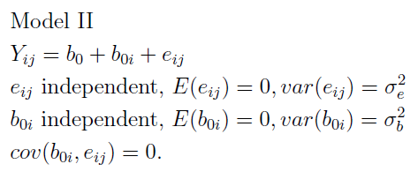
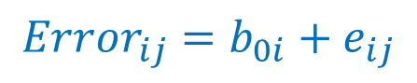

$$Y_{ij}=b_{0}+{Error}_{ij}$$
$${Error}_{ij}={b_{0i}+e}_{ij}$$
How would a picture of the model look like?

Slide 12
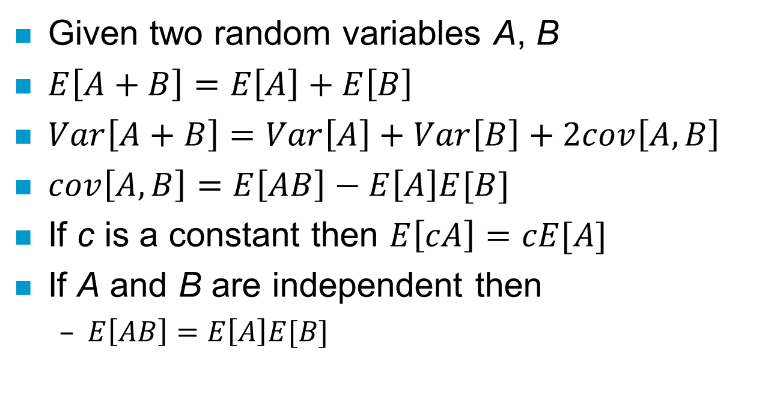
Useful formulae
Given two random variables A, B
$E\left[A+B\right]=E\left[A\right]+E\left[B\right]$
$Var\left[A+B\right]=Var\left[A\right]+Var\left[B\right]+2cov\left[A,B\right]$
$cov\left[A,B\right]=E\left[AB\right]−E\left[A\right]E[B]$
If c is a constant then $E\left[cA\right]=cE[A]$
If A and B are independent then
$E\left[AB\right]=E\left[A\right]E[B]$

Slide 13
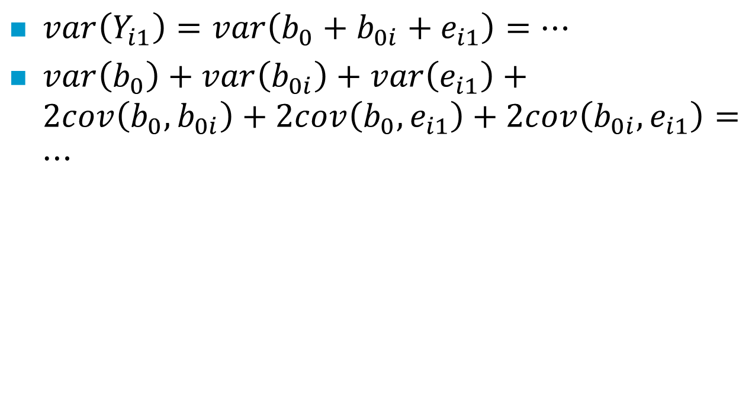
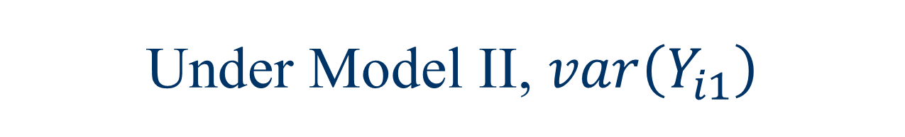
Under Model II, $var\left(Y_{i1}\right)$
$var\left(Y_{i1}\right)=var\left(b_{0}+b_{0i}+e_{i1}\right)=…$
$var\left(b_{0}\right)+var\left(b_{0i}\right)+var\left(e_{i1}\right)+2cov\left(b_{0},b_{0i}\right)+2cov\left(b_{0},e_{i1}\right)+2cov\left(b_{0i},e_{i1}\right)=…$

Slide 14
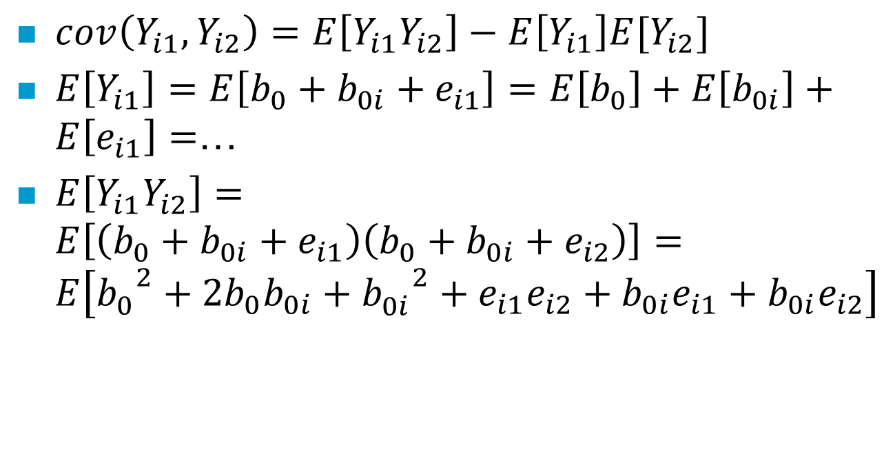

Under Model II, cov$\left(Y_{i1}, Y_{i2}\right)$
$cov\left(Y_{i1}, Y_{i2}\right)=E\left[Y_{i1}Y_{i2}\right]−E\left[Y_{i1}\right]E[Y_{i2}]$
$E\left[Y_{i1}\right]=E\left[b_{0}+b_{0i}+e_{i1}\right]=E\left[b_{0}\right]+E\left[b_{0i}\right]+E\left[e_{i1}\right]=$…
$E\left[Y_{i1}Y_{i2}\right]=E\left[\left(b_{0}+b_{0i}+e_{i1}\right)\left(b_{0}+b_{0i}+e_{i2}\right)\right]=E\left[{b_{0}^{}}^{2}+2b_{0}b_{0i}+{b_{0i}^{}}^{2}+e_{i1}e_{i2}+{b_{0i}e}_{i1}+{b_{0i}e}_{i2}\right]$

Slide 15
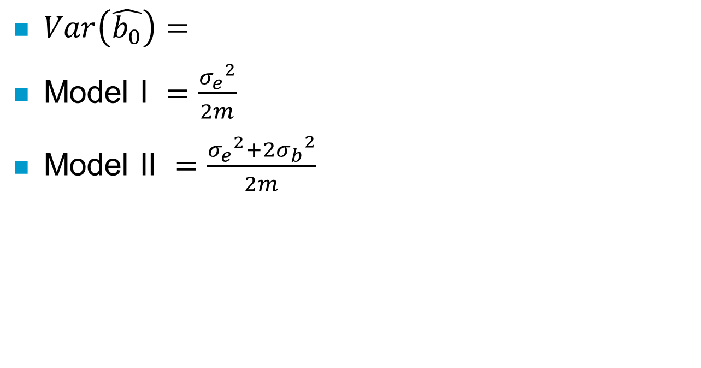
Two V matrices under the two models would give standard error estimates
$Var\left(\hat{b_{0}}\right)=$
Model I $=\frac{{σ_{e}}^{2}}{2m}$
Model II $=\frac{{σ_{e}}^{2}+{{2σ}_{b}}^{2}}{2m}$
Estimated from sample variance
Estimated from sample co-variance

Slide 16
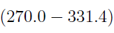
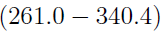
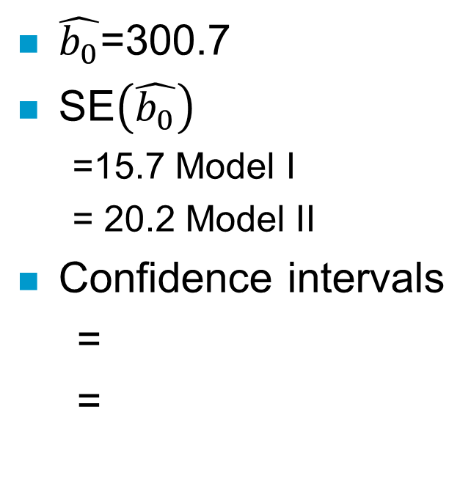
Results of estimates of b₀
$\hat{b_{0}}$=300.7
SE$\left(\hat{b_{0}}\right)$
=15.7 Model I
= 20.2 Model II
Confidence intervals
=
=

Slide 17
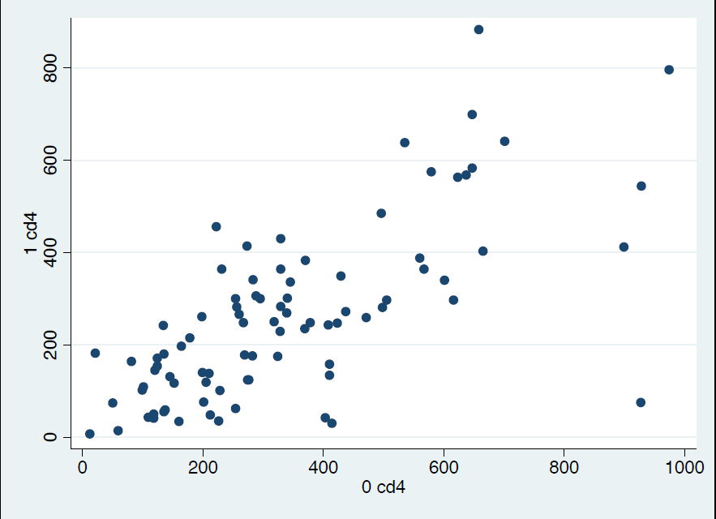
What is a better model of the data?

Slide 18
So far, to compute confidence interval of statistic (eg.mean)…
We have assumed a model that allowed us to estimate the variance-covariance matrix
We have good reasons to assume a probability distribution (Central Limit Theorem)

Slide 19
What if?
Cannot get a good estimate the variance-covariance matrix
Not possible
You are lazy to go through the algebra
Don’t have sufficient reason to assume a probability distribution of the statistic of interest

Slide 20
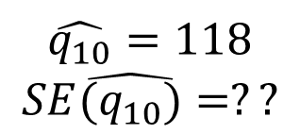
Estimate the 10th quantile of CD4 at low viral load
$$\hat{q_{10}}=118$$
$$SE\hat{(q_{10})}=??$$

Slide 21
What does the standard error of a statistic supposed to represent?
The standard deviation of the estimates of this statistic in repeating experiments of the same kind
The 10th quantile was easy enough to compute for the data from our experiments
What if we could repeat the experiments?

Slide 22
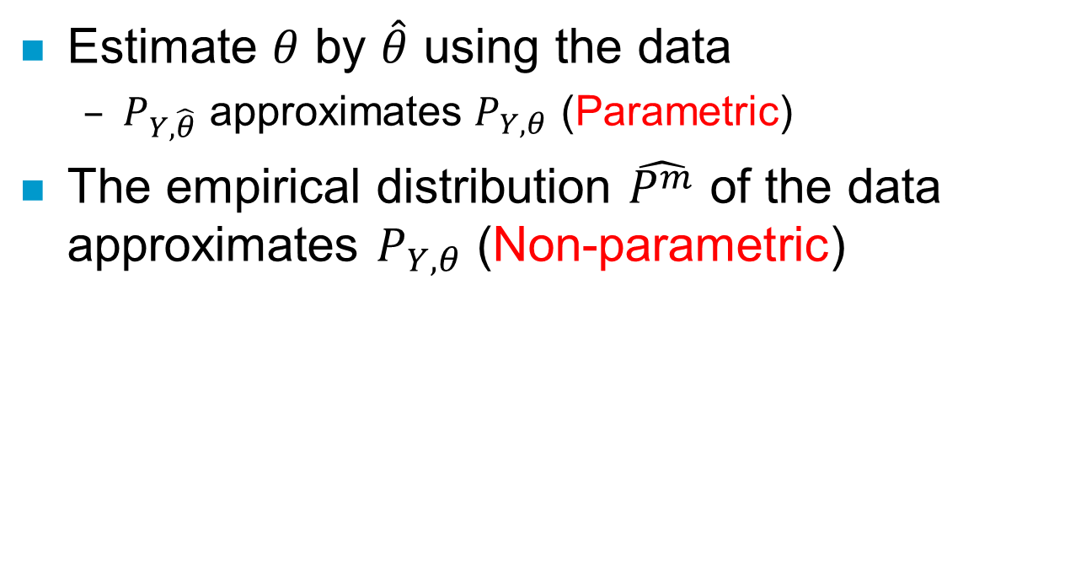
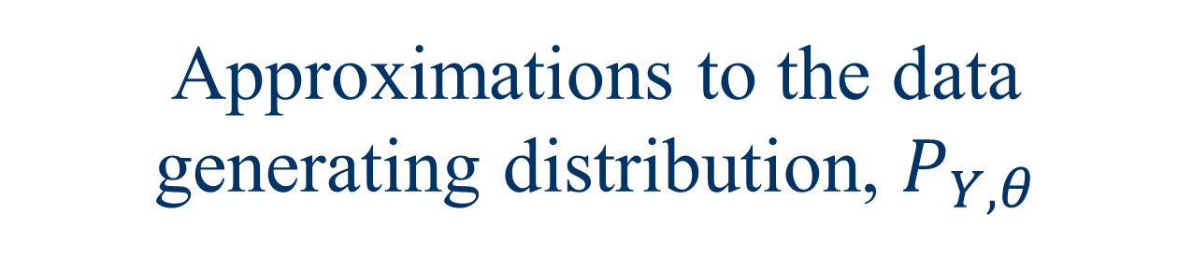
Approximations to the data generating distribution, $P_{Y,θ}$
Estimate $θ$ by $\hat{θ}$ using the data
$P_{Y,\hat{θ}}$ approximates $P_{Y,θ}$ (Parametric)
The empirical distribution $\hat{P^{m}}$ of the data approximates $P_{Y,θ}$ (Non-parametric)

Slide 23
Data from repeated experiments
Original experiment data
Repeated experiment data

Slide 24
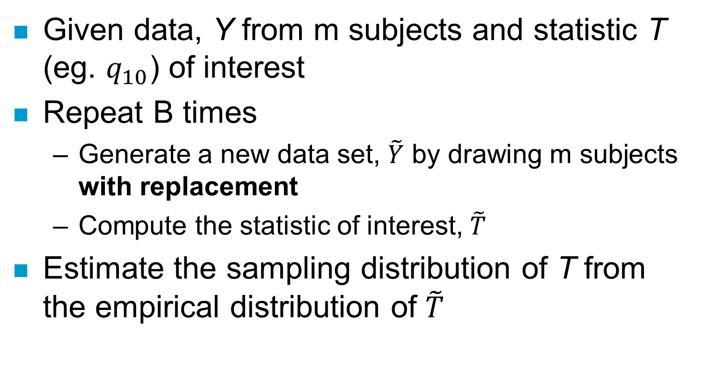
Non-parametric bootstrap procedure
Given data, Y from m subjects and statistic T (eg. $q_{10}$) of interest
Repeat B times
Generate a new data set, $\tilde{Y}$ by drawing m subjects with replacement
Compute the statistic of interest, $\tilde{T}$
Estimate the sampling distribution of T from the empirical distribution of $\tilde{T}$

Slide 25
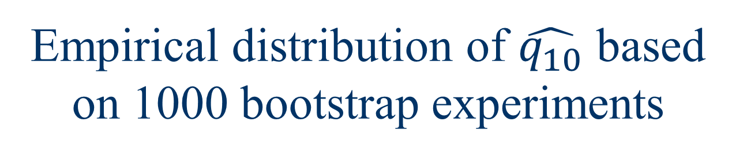
Empirical distribution of $\hat{q_{10}}$ based on 1000 bootstrap experiments
95% CI based on 2.5% and 97.5% quantiles of
sampling distribution: (81-136)

Slide 26
Important consideration for longitudinal data
Bootstrap procedure must respect the dependence relationships between observations
Clustering Bootstrap procedure

Slide 27
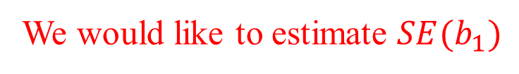
What is the effect of viral load on CD4 count?
Simple linear model: $Y_{ij}=b_{0}+b_{1}\left(VL>2000\right)+e_{ij}$
We would like to estimate $SE(b_{1})$

Slide 28
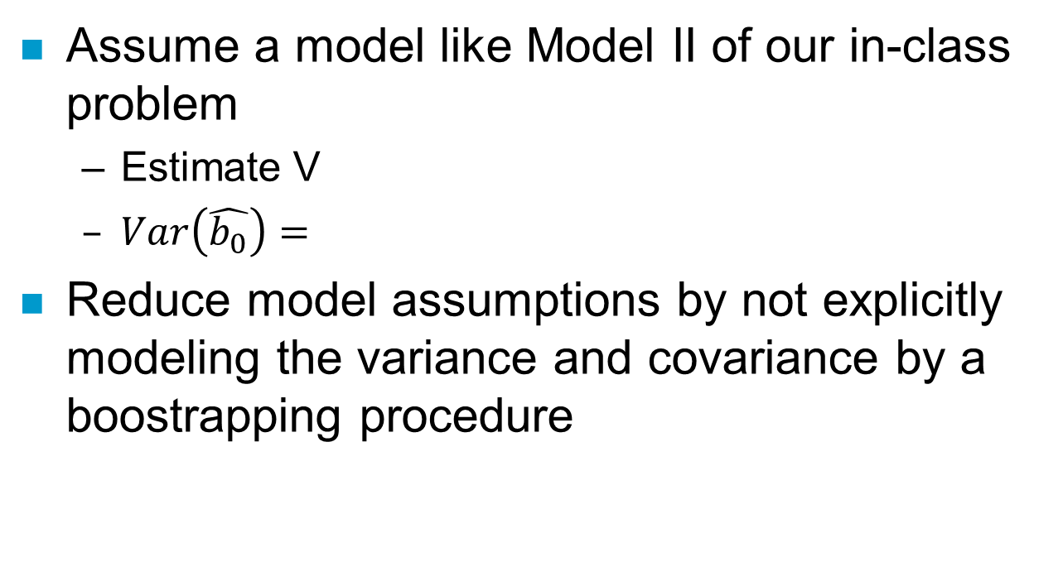

Options to estimate a confidence interval $SE(b_{1})$
Assume a model like Model II of our in-class problem
Estimate V
$Var\left(\hat{b_{0}}\right)=$
Reduce model assumptions by not explicitly modeling the variance and covariance by a boostrapping procedure

Slide 29
Would you bootstrap observations?

Slide 30
Standard linear regression

Slide 31
Linear Mixed Effects Regression

Slide 32
Clustered Bootstrap of standard linear regressions

Slide 33
Sampling distribution of b₁

Slide 34
Quick Summary of Repeated Measures Strategies
Transition Models Relies on some assumption of conditional independence of repeated outcomes, by adjusting for previous outcome value: E(Y_{ij}|X_{ij},Y_{i(j-1)}).
Mixed Effects Models – explicit model of sources of random variability at cluster level, E(Y_{ij}|X_{ij},α_{i}), α_{i}~N(0,σ²_{α}),….
Generalized Estimating Equation (GEE) approach – only specify relative simple parameters (e.g., E(Y_{ij}|X_{ij})).

Slide 35
Example: observations within subjects: The Effect of Drug and Alcohol Use on Teenage Sexual Activity
Minnis & Padian (2001) conducted a longitudinal study of teenagers in San Rafael, California to investigate the association between drug and alcohol use and sexual activity on the same day.
Participants were asked to keep track of their activities over approximately one month and binary indicator variables were created to show whether drug/alcohol use and/or sexual activity were reported for each 24 hour period.
Notes:
Sources of variation include 1) baseline CD4 count, 2) viral load, 3) relationship of viral load to CD4 count, 4) measurement error

Slide 36
Example of Binary Outcome: Sex, Drugs and Teenagers
A longitudinal study of the effects of drug-use on sexual activity.
Let X_{ij}, the only explanatory variable of interest for now, indicate whether or not subject i reported drug-use (1=yes, 0=no) on day j.
Let Y_{ij} denote whether subject had sex (1=yes, 0=no), i.e., Y_{ij} is a binary outcome and thus its expectation can be modeled via the logit transform.

Slide 37
Data
eid today drgalcoh sx24hrs
1. 10122 03 Jun 98 yes no
2. 10123 04 Jun 98 no no
3. 10123 05 Jun 98 no no
4. 10123 06 Jun 98 yes no
5. 10123 07 Jun 98 no no
6. 10123 08 Jun 98 no no
7. 10123 09 Jun 98 no no
8. 10123 12 Jun 98 no no
9. 10123 14 Jun 98 yes no
10. 10123 16 Jun 98 no no
11. 10123 17 Jun 98 no no
12. 10123 18 Jun 98 no yes
13. 10123 19 Jun 98 no no
14. 10123 20 Jun 98 no no
15. 10123 21 Jun 98 no no
16. 10123 23 Jun 98 no no
17. 10123 25 Jun 98 no yes
18. 10123 28 Jun 98 no no
19. 10123 29 Jun 98 no yes
20. 10123 01 Jul 98 no yes
21. 10123 02 Jul 98 no no
22. 10123 03 Jul 98 no no
23. 10123 04 Jul 98 no no
24. 10123 05 Jul 98 no no
25. 10124 04 Jun 98 no no
26. 10124 07 Jun 98 no no
27. 10124 08 Jun 98 no no

Slide 38
Transition Model for Teenage Sex and Drug-Use
For time-sequenced repeated measures, build the joint distribution by specifying a sequence of distributions that are conditioned on previous measurements on the individual. These are called transition (Markov) models.
For the study of teenage sex:
where Y_{i1} is outcome at time t_{i1},Y_{i2} at t_{i2}, ..., and t_{i1} < t_{i2} <... < t_{ini} .

Slide 39
Transition Model for Teenage Sex and Drug-Use
This approach constructs the likelihood, for the case of this model
under the assumption that:

Slide 40
Transition Models
exp(δ) = odds ratio (OR) of among subjects who did versus did not have sex during the prior day, keeping drug status fixed.
exp(β₁TM) = OR of drug use vs. not for either subjects who reported having sex or did not have sex the previous day.
use generalized linear models (glm) software (e.g., linear, logistic, poisson regression).
Most commonly used for nice, time-structured data.

Slide 41
Sexual Activity and drug/alcohol use among teenagers revisted
Main Variables
sex24hrs - sex in last 24 hrs. (0=no, 1=yes)
drgalcoh - drug or alcohol use in last 24 hrs.
tues-sun - dummy variables designating day of
week

Slide 42
Results using xtgee in STATA
.sort eid today
* This is how one puts Y_{ij-1} onto same line as Y_{ij} to be used as covariate
.by eid: gen sxyest = sx24hrs[_n-1]
.by eid: replace sxyest = . if _n==1
.logistic sx24hrs drgalcoh sxyest
. Logit estimates Number of obs = 1607
LR chi2(2) = 55.39
Prob > chi2 = 0.0000
Log likelihood = -942.60915 Pseudo R2 = 0.0285
------------------------------------------------------------------------------
sx24hrs | Odds Ratio Std. Err. z P>|z| [95% Conf. Interval]
-------------+----------------------------------------------------------------
exp(β₁TM)drgalcoh 1.63798 .1986677 4.07 0.000 1.291421 2.07754
exp(δ) sxyes 2.051903 .2478562 5.95 0.000 1.619338 2.600018
------------------------------------------------------------------------------

Slide 43
Random Effects Models
Uses a random effect to model the relative similarity of observations made on same statistical unit (e.g., person)
Assumes Y_{ij} and Y_{ik}, j≠k are independent given some realized value of a random effect (β_{i0}) and the covariates.
The model assumes these random effects are randomly drawn from a known distribution.

Slide 44
Random Effects Model for Teenage Sex and Drug-Use
Assume that the repeated observations for the ith teenager are independent of one another given β_{i0} and X_{ij}.
Must assume parametric distribution for the β_{i0} , usually β_{i0} ~N(0,τ²).
exp(β₁RE) is odds ratio for having sex infection when subject i reports drug-use relative to when same subject does not report drug-use.

Slide 45
Motivation for This Approach
Natural for modeling heterogeneity across individuals in their regression coefficients.
This heterogeneity can be represented by a probability distribution
Most useful when object is to make inferences about individuals rather than population averages.

Slide 46
Motivation for This Approach
Also useful to estimate the contributions to variability from different sources (e.g., within and among individuals).
Can be extended to hierarchy of units (multi-level modeling), such as repeated longitudinal measures of a person, within a household, within a community .....

Slide 47
Some available software for random effects models
Linear Models
Proc Mixed in SAS
xtreg in STATA (only simple random effects models)
xtmixed in STATA 10
lme in R
Logistic and Poisson Models
xtlogit and xtpoisson in STATA for simple random effects, xtmelogit and xtmepoisson for general mixed models in STATA version 10
gllamm – for general mixed models is STATA add-on

Slide 48
Random effects using xtlogit in STATA
. xtlogit sx24hrs drgalcoh, or i(eid) re
Random-effects logit Number of obs = 1708
Group variable (i) : eid Number of groups = 109
Random effects u_i ~ Gaussian Obs per group: min = 1
avg = 15.7
max = 33
Wald chi2(1) = 5.48
Log likelihood = -921.39213 Prob > chi2 = 0.0192
------------------------------------------------------------------------------
sx24hrs | OR Std. Err. z P>|z| [95% Conf. Interval]
-------------+----------------------------------------------------------------
exp(β₁RE) 1.447266 .2284893 2.34 0.019 1.062096 1.972119
-------------+----------------------------------------------------------------
/lnsig2u | .5483488 .2428238 .0724228 1.024275
-------------+----------------------------------------------------------------
τ sigma_u | 1.315444 .1597106 1.036875 1.668854
rho | .3446819 .0166718 .2463036 .4584528
------------------------------------------------------------------------------
Likelihood ratio test of rho=0: chibar2(01) = 184.17 Prob >= chibar2 = 0.000

Slide 49
Estimation of Marginal Models (GEE)
Estimate marginal mean model.
Marginal model is a population, not individual, model.
The marginal E[Y_{ij} | X_{ij}= x_{ij}] is defined as the mean value of an observation Y_{ij} in the theoretical experiment where one randomly draws an observation from a population where everyone has X_{ij}= x_{ij}.

Slide 50
Marginal Models (GEE)
For instance, if Y_{ij} is the cholesterol and X_{ij} = yes if one smokes, no otherwise. In a marginal model, E[Y_{ij} | X_{ij} = yes] will be the mean of a randomly drawn Y_{ij} from the sub-population where everyone smokes.

Slide 51
Parameter Interpretation in a marginal model
Parameters in an equivalent random effects and GEE model have subtly different interpretations.
Coefficients in a random effects model represent expected differences (odds ratios, relative risks, etc) within an individual, given a change in their X from one value to another
Coefficients in a marginal model represent expected differences (odds ratios, relative risks, etc) within an population, given a change in everyone’s X from one value to another.

Slide 52
Parameter Interpretation in a GEE model, cont.
In linear, log-linear models, the random effects and marginal regression parameters are the same.
In Logistic regression, they are different – more later.

Slide 53
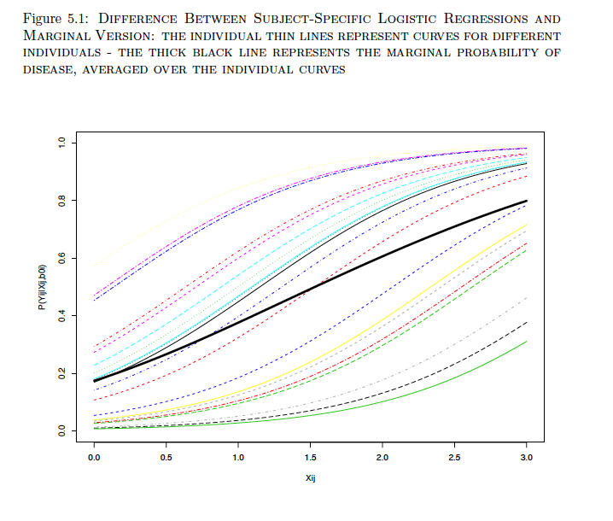
Notes:
53

Slide 54
Marginal Models (GEE)
GEE software typically allows several different “working” correlation models (e.g., exchangeable, auto-regressive, unstructured, etc.).
These correlation models are used to build weight matrices, which are used in a weighted regression.
When deriving inferences for the coefficients, though, it calculates “robust” standard errors.

Slide 55
Examples of Correlation Models
Each individual is independent of all others
Correlation within individuals across longitudinal observations has the same structure

Slide 56
Structure for R₀
General structure:
A lot of unknown parameters

Slide 57
Correlation Models (contd): Uniform correlation (compound symmetry or exchangeable)
Arises from random effects model
Errors uncorrelated, and independent of and

Slide 58
Correlation Models (contd):Time-Decaying Correlations (Auto-regressive)
Auto-regressive:
Not great for unequally spaced
longitudinal data
Exponential correlation model generalizes
this to rather than

Slide 59
Examples of var-cov. models

Slide 60
The GEE Algorithm
Algorithm is similar to the one used for the non-repeated measures problems (e.g., OLS for continuous data, logistic regression for binary and Poisson regression for counts).
Let R(α) be a n_{i} x n_{i} "working" correlation matrix that is fully characterized by a vector of parameters, α.
V_{i} is again the variance-covariance of the observations which will be a function of the mean (E(Y_{i}|X_{i})), a scale parameter, φ and R(α).

Slide 61
Standard Errors of Coefficients
GEE will normally return two estimates of the variance of the coefficient estimates, 1) naive and 2) robust.
Naive assumes that the chosen model for R(α), such as compound symmetry, is correct.
Robust is a more nonparametric estimate that does not assume your guess for R(α) is correct. However, its variance estimates can be more variable.

Slide 62
GEE Marginal Model for Teenage Sex and Drug-Use
var(Y_{ij})= μ_{ij} (1-μ_{ij})*, corr(Y_{ij}, Y_{ik}) = ρ (i.e., assume compound symmetry).
exp(β₁^{M}) is a ratio of population frequencies, i.e., it is a population averaged parameter. It is the odds ratio of the probabilities (proportions) of teenagers who would engage in sexual activity in populations reporting drug use vs. populations not reporting drug-use.
* Semi-robust inference – can you tell why?

Slide 63
Sexual Activity and drug/alcohol use among teenagers revisted
Main Variables
sex24hrs - sex in last 24 hrs. (0=no, 1=yes)
drgalcoh - drug or alcohol use in last 24 hrs.
tues-sun - dummy variables designating day of
week

Slide 64
Results using xtgee in STATA
robust SE
. xtgee sx24hrs drgalcoh, eform i(id) family(binomial) cor(ind) robust
GEE population-averaged model Number of obs = 1708
Group variable: id Number of groups = 109
Link: logit Obs per group: min = 1
Family: binomial avg = 15.7
Correlation: independent max = 33
(standard errors adjusted for clustering on id)
------------------------------------------------------------------------------
| Semi-robust
sx24hrs | Odds Ratio Std. Err. z P>|z| [95% Conf. Interval]
-------------+----------------------------------------------------------------
exp(β₁^{M})drgalcoh 1.739521 .3149874 3.06 0.002 1.219823 2.480635
------------------------------------------------------------------------------
non-robust (naive) SE
. xtgee sx24hrs drgalcoh, eform i(eid) family(binomial) cor(ind)
------------------------------------------------------------------------------
sx24hrs | Odds Ratio Std. Err. z P>|z| [95% Conf. Interval]
-------------+----------------------------------------------------------------
drgalcoh | 1.739521 .20244 4.76 0.000 1.384744 2.185194
------------------------------------------------------------------------------

Slide 65
xtgee Options
family(?), link(?) -- identify that we wish linear regression with continuous outcome (as compared to, say, binary outcomes – more later)
corr(ind) -- identify that we will assume independence for our correlation structure (some other possibilities include exchangeability and autoregressive structures)
i(?)--identify which variable indentifies the individual (or cluster)
ro -- identifies that we wish robust estimates of variability

Slide 66
Model 2 – same marginal model, different working correlation.
x_{ij} = 0 if drug/alcohol use is no, 1 if yes
y_{ij} = 0 if no sex in last 24 hours, 1 if yes
cor(Yij,Yij’)=ρ (compound symmetry or exchangeable correlation structure)

Slide 67
Results of Model 2 using STATA
robust SE
. xtgee sx24hrs drgalcoh, eform i(id) family(binomial) cor(exc) robust
GEE population-averaged model Number of obs = 1708
Group variable: id Number of groups = 109
Link: logit Obs per group: min = 1
Family: binomial avg = 15.7
Correlation: exchangeable max = 33
(standard errors adjusted for clustering on id)
------------------------------------------------------------------------------
| Semi-robust
sx24hrs | Odds Ratio Std. Err. z P>|z| [95% Conf. Interval]
-------------+----------------------------------------------------------------
drgalcoh | 1.393705 .1919735 2.41 0.016 1.063956 1.825653
------------------------------------------------------------------------------
non-robust (naive) SE
. xtgee sx24hrs drgalcoh, eform i(eid) family(binomial) cor(exc)
------------------------------------------------------------------------------
sx24hrs | Odds Ratio Std. Err. z P>|z| [95% Conf. Interval]
-------------+----------------------------------------------------------------
drgalcoh | 1.393705 .1701631 2.72 0.007 1.097095 1.770507
------------------------------------------------------------------------------

Slide 68
Estimated Working Correlation
. xtcorr
c1 c2 c3 c4 c5 c6 c7 c8 c9
r1 1.0000
r2 0.1614 1.0000
r3 0.1614 0.1614 1.0000
r4 0.1614 0.1614 0.1614 1.0000
r5 0.1614 0.1614 0.1614 0.1614 1.0000
r6 0.1614 0.1614 0.1614 0.1614 0.1614 1.0000
r7 0.1614 0.1614 0.1614 0.1614 0.1614 0.1614 1.0000
r8 0.1614 0.1614 0.1614 0.1614 0.1614 0.1614 0.1614 1.0000
r9 0.1614 0.1614 0.1614 0.1614 0.1614 0.1614 0.1614 0.1614 1.0000
r10 0.1614 0.1614 0.1614 0.1614 0.1614 0.1614 0.1614 0.1614 0.1614
r11 0.1614 0.1614 0.1614 0.1614 0.1614 0.1614 0.1614 0.1614 0.1614
r12 0.1614 0.1614 0.1614 0.1614 0.1614 0.1614 0.1614 0.1614 0.1614
r13 0.1614 0.1614 0.1614 0.1614 0.1614 0.1614 0.1614 0.1614 0.1614
r14 0.1614 0.1614 0.1614 0.1614 0.1614 0.1614 0.1614 0.1614 0.1614
r15 0.1614 0.1614 0.1614 0.1614 0.1614 0.1614 0.1614 0.1614 0.1614
r16 0.1614 0.1614 0.1614 0.1614 0.1614 0.1614 0.1614 0.1614 0.1614
r17 0.1614 0.1614 0.1614 0.1614 0.1614 0.1614 0.1614 0.1614 0.1614
r18 0.1614 0.1614 0.1614 0.1614 0.1614 0.1614 0.1614 0.1614 0.1614
r19 0.1614 0.1614 0.1614 0.1614 0.1614 0.1614 0.1614 0.1614 0.1614

Slide 69
Model 3 – adjusting for day of week
x_{ij} = 1 if drug/alcohol use is yes, 0 if no
z_{1ij} = 1 if interview day is Tuesday, 0 if not
z_{2ij} = 1 if interview day is Wed., 0 if not.....
z_{6ij} = 1 if interview day is Sunday, 0 if not
y_{ij} = 1 if sex in last 24 hours, 0 if no
cor(Yij,Yij’)=ρ (compound symmetry or exchangeable correlation structure)

Slide 70
Results of Model 3 using STATA
. xtgee sx24hrs drgalcoh tues wed thur fri sat sun, eform i(id) family(binomial
> ) cor(exc) robust
GEE population-averaged model Number of obs = 1708
Group variable: id Number of groups = 109
Link: logit Obs per group: min = 1
Family: binomial avg = 15.7
Correlation: exchangeable max = 33
Wald chi2(7) = 11.40
Scale parameter: 1 Prob > chi2 = 0.1220
(standard errors adjusted for clustering on id)
------------------------------------------------------------------------------
| Semi-robust
sx24hrs | Odds Ratio Std. Err. z P>|z| [95% Conf. Interval]
-------------+----------------------------------------------------------------
drgalcoh | 1.373029 .1845197 2.36 0.018 1.055086 1.786782
tues | 1.239246 .2320747 1.15 0.252 .8585234 1.788804
wed | 1.234437 .2523307 1.03 0.303 .826942 1.842734
thur | 1.099757 .233122 0.45 0.654 .7258761 1.666215
fri | .9833647 .1933837 -0.09 0.932 .6688388 1.445799
sat | 1.277403 .2490991 1.26 0.209 .8716457 1.872043
sun | 1.577958 .306514 2.35 0.019 1.078331 2.30908
------------------------------------------------------------------------------

Slide 71
Model for drug/alcohol use vs. day of week
X_{ij} = 1 if drug/alcohol use is yes, 0 if no
z_{1ij} = 1 if interview day is Tuesday, 0 if not
z_{2ij} = 1 if interview day is Wed., 0 if not.....
z_{6ij} = 1 if interview day is Sunday, 0 if not
cor(Yij,Yij’)=ρ (compound symmetry or exchangeable correlation structure)

Slide 72
Results of drug/alcohol use Model using STATA
. xtgee drgalcoh tues wed thur fri sat sun, eform i(id) family(binomial) cor(ex
> c) robust
GEE population-averaged model Number of obs = 1708
Group variable: id Number of groups = 109
Link: logit Obs per group: min = 1
Family: binomial avg = 15.7
Correlation: exchangeable max = 33
Wald chi2(6) = 28.91
Scale parameter: 1 Prob > chi2 = 0.0001
(standard errors adjusted for clustering on id)
------------------------------------------------------------------------------
| Semi-robust
drgalcoh | Odds Ratio Std. Err. z P>|z| [95% Conf. Interval]
-------------+----------------------------------------------------------------
tues | .7484218 .1301296 -1.67 0.096 .5322875 1.052317
wed | .7043399 .1440654 -1.71 0.087 .4717131 1.051687
thur | .9226514 .171617 -0.43 0.665 .6407825 1.328509
fri | 1.197263 .2206008 0.98 0.329 .834357 1.718015
sat | 1.666645 .3147173 2.71 0.007 1.151088 2.413115
sun | 1.371219 .205994 2.10 0.036 1.021488 1.840688
------------------------------------------------------------------------------

Slide 73
Continuous Outcome Example (Linear Model): Respiratory Function
Random sample of 300 girls from Topeka
Measurements of fev₁, height, age (fev₁ is forced expired volume in first second after spirometry in ml)

Slide 74
OLS -- ignores correlation (no robust variabilty estimates)
. xtgee lnfev age, family(gaussian) link(id) corr(ind) i( childid)
GEE population-averaged model Number of obs = 1994
Group variable: childid Number of groups = 300
Link: identity Obs per group: min = 1
Family: Gaussian avg = 6.6
Correlation: independent max = 12
Wald chi2(1) = 6299.69
Scale parameter: .0262556 Prob > chi2 = 0.0000
Pearson chi2(1994): 52.35 Deviance = 52.35
Dispersion (Pearson): .0262556 Dispersion = .0262556
------------------------------------------------------------------------------
lnfev | Coef. Std. Err. z P>|z| [95% Conf. Interval]
------------------------------------------------------------------------------
age | .0866927 .0010923 79.37 0.000 .084552 .0888335
_cons | -.2741518 .014197 -19.31 0.000 -.3019775 -.2463261
------------------------------------------------------------------------------

Slide 75
(Same as OLS on entire data set)
. regress lnfev age
------------------------------------------------------------------------------
lnfev | Coef. Std. Err. t P>|t| [95% Conf. Interval]
------------------------------------------------------------------------------
age | .0866927 .0010928 79.33 0.000 .0845496 .0888359
_cons | -.2741518 .0142042 -19.30 0.000 -.3020084 -.2462953
------------------------------------------------------------------------------

Slide 76
OLS with Robust Variability Estimates
. xtgee lnfev age, family(gaussian) link(id) corr(ind) i( childid) ro
GEE population-averaged model Number of obs = 1994
Group variable: childid Number of groups = 300
Link: identity Obs per group: min = 1
Family: Gaussian avg = 6.6
Correlation: independent max = 12
(standard errors adjusted for clustering on childid)
------------------------------------------------------------------------------
| Semi-robust
lnfev | Coef. Std. Err. z P>|z| [95% Conf. Interval]
------------------------------------------------------------------------------
age | .0866927 .0011288 76.80 0.000 .0844804 .0889051
_cons | -.2741518 .0158196 -17.33 0.000 -.3051577 -.2431459
------------------------------------------------------------------------------
.0011288 as compared to non-robust .0010923 (and .0158 vs .0142)

Slide 77
Review of Modeling Longitudinal vs. X-sectional Associations
Consider the model:
β_{L} represents the expected change in Y given a change in X_{ij} relative to the baseline value (X_{i1}) - longitudinal effect.
β_{C} represents the expected difference in average Y across two sub-populations that differ by their baseline values, X_{i1} - cross-sectional effect.

Slide 78
Alternative Parameterization
An identical fit to the data would be:
β_{L} still represents the expected change in Y given a change in X_{ij} relative to the baseline value (X_{i1}) - longitudinal effect.
β*_{C} represents the difference in the x-sectional vs. longitudinal (or β*_{C} = β_{C}-β_{L}).

Slide 79
Model for Lung Function
Consider the model:
with X_{ij1} height for subject i, time j, and X_{ij2} is the corresponding age.

Slide 80
More complicated Model -- still OLS
xtgee lnfev lnheight age initlnheight initage, family(gaussian) link(id) corr(ind) i( childid)
GEE population-averaged model Number of obs = 1994
Group variable: childid Number of groups = 300
Link: identity Obs per group: min = 1
Family: Gaussian avg = 6.6
Correlation: independent max = 12
Wald chi2(4) = 14199.25
Scale parameter: .0134473 Prob > chi2 = 0.0000
------------------------------------------------------------------------------
lnfev | Coef. Std. Err. z P>|z| [95% Conf. Interval]
------------------------------------------------------------------------------
lnheight | 2.056183 .0699129 29.41 0.000 1.919156 2.19321
age | .0284979 .0021109 13.50 0.000 .0243606 .0326352
initlnheight | .4074967 .0839699 4.85 0.000 .2429187 .5720746
initage | -.016087 .0040224 -4.00 0.000 -.0239708 -.0082032
_cons | -.3309375 .02105 -15.72 0.000 -.3721947 -.2896803
------------------------------------------------------------------------------

Slide 81
More complicated Model, different parameterization
xtgee lnfev lnheightchange agechange initlnheight initage, family(gaussian) link(id) corr(ind)
i(childid)
Iteration 1: tolerance = 1.427e-13
GEE population-averaged model Number of obs = 1994
Group variable: childid Number of groups = 300
Link: identity Obs per group: min = 1
Family: Gaussian avg = 6.6
Correlation: independent max = 12
Wald chi2(4) = 14199.25
Scale parameter: .0134473 Prob > chi2 = 0.0000
Pearson chi2(1994): 26.81 Deviance = 26.81
Dispersion (Pearson): .0134473 Dispersion = .0134473
------------------------------------------------------------------------------
lnfev | Coef. Std. Err. z P>|z| [95% Conf. Interval]
-------------+----------------------------------------------------------------
lnheightchange 2.056183 .0699129 29.41 0.000 1.919156 2.19321
agechange | .0284979 .0021109 13.50 0.000 .0243606 .0326352
initlnheight | 2.46368 .0649965 37.90 0.000 2.336289 2.591071
initage | .0124109 .003436 3.61 0.000 .0056765 .0191453
_cons | -.3309375 .02105 -15.72 0.000 -.3721947 -.2896803
------------------------------------------------------------------------------

Slide 82
More complicated Model -- still OLS + Robust
xtgee lnfev lnheight age initlnheight initage, family(gaussian) link(id) corr(ind) i( childid) ro
GEE population-averaged model Number of obs = 1994
Group variable: childid Number of groups = 300
Link: identity Obs per group: min = 1
Family: Gaussian avg = 6.6
Correlation: independent max = 12
(standard errors adjusted for clustering on childid)
------------------------------------------------------------------------------
| Semi-robust
lnfev | Coef. Std. Err. z P>|z| [95% Conf. Interval]
------------------------------------------------------------------------------
lnheight | 2.056183 .0792847 25.93 0.000 1.900788 2.211578
age | .0284979 .0022755 12.52 0.000 .024038 .0329578
initlnheight | .4074967 .1828943 2.23 0.026 .0490305 .7659628
initage | -.016087 .008835 -1.82 0.069 -.0334034 .0012293
_cons | -.3309375 .0432665 -7.65 0.000 -.4157383 -.2461367
------------------------------------------------------------------------------

Slide 83
More complicated Model, different parameterization
. xtgee lnfev lnheightchange agechange initlnheight initage, family(gaussian) link(id) corr(ind)
i( childid) ro
Iteration 1: tolerance = 1.427e-13
GEE population-averaged model Number of obs = 1994
Group variable: childid Number of groups = 300
Link: identity Obs per group: min = 1
Family: Gaussian avg = 6.6
Correlation: independent max = 12
Wald chi2(4) = 11417.58
Scale parameter: .0134473 Prob > chi2 = 0.0000
Pearson chi2(1994): 26.81 Deviance = 26.81
Dispersion (Pearson): .0134473 Dispersion = .0134473
(standard errors adjusted for clustering on childid)
------------------------------------------------------------------------------
| Semi-robust
lnfev | Coef. Std. Err. z P>|z| [95% Conf. Interval]
-------------+----------------------------------------------------------------
lnheightch~e | 2.056183 .0792847 25.93 0.000 1.900788 2.211578
agechange | .0284979 .0022755 12.52 0.000 .024038 .0329578
initlnheight | 2.46368 .1775394 13.88 0.000 2.115709 2.811651
initage | .0124109 .0087532 1.42 0.156 -.0047451 .0295668
_cons | -.3309375 .0432665 -7.65 0.000 -.4157383 -.2461367
------------------------------------------------------------------------------

Slide 84
Comparison of Standard Errors
Variable | Naïve SE | Robust SE | Naïve z | Robust z
lnheight | .0699 | .0793 | 29.4 | 25.9
age | .0021 | .0023 | 13.5 | 12.5
initlnheight | .0840 | .1829 | 4.8 | 2.2
initage | .0040 | .0088 | -4.0 | -1.8
_cons | .0211 | .0433 | -15.7 | -7.6

